Slide 1
Valorisation of EAF slag through a defined reduction method
David Algermissen
Henning Schliephake, Marija Cancarevic Georgsmarienhütte
Hans-Joachim Rauen, Hamid Tabani Hermann Rauen
Rüdiger Deike, Marius Großarth University of Duisburg

Slide 2
Use of EAF slag in Germany
today and tomorrow

Slide 3
Motivation
1.51 M t Electirc Arc Furnace Slag (C/Q)
Production
(Germany)
Upcoming regulation
Today
Future?
Source: Fachverband Eisenhüttenschlacken, Duisburg
Assumption: 15 % classified as SWS-1
No application for SWS-2 / -3

Slide 4
0%
100%
silica-rich fly ash
calcareous fly ash
GBS
Portland cement clinker
Adding silica
containing materials
CaO
SiO₂
50%
50%
Adding lime
containing materials
reduction
in lab
EAFS
100%
0%
0%
50%
100%
Al₂O₃ + Fe₂O₃

Slide 5
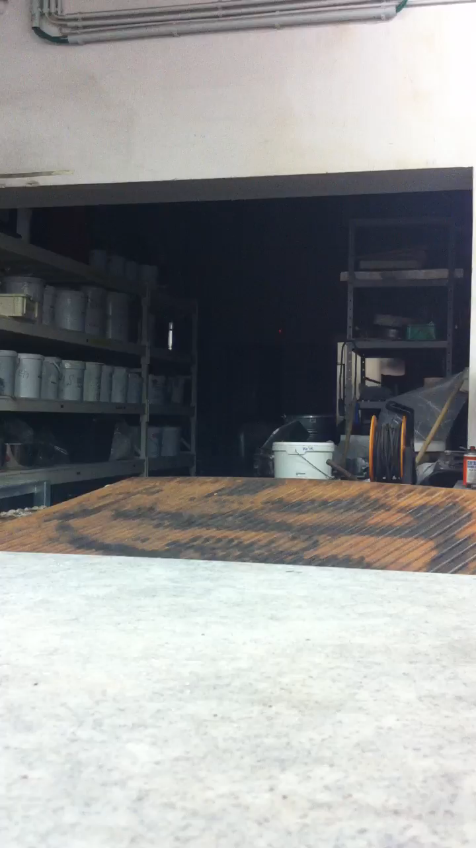
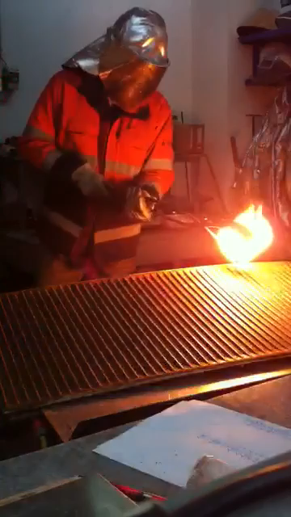
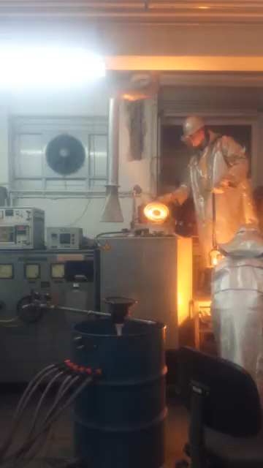
regular remelting
lime addition
silica addition +
water granulation

Slide 6
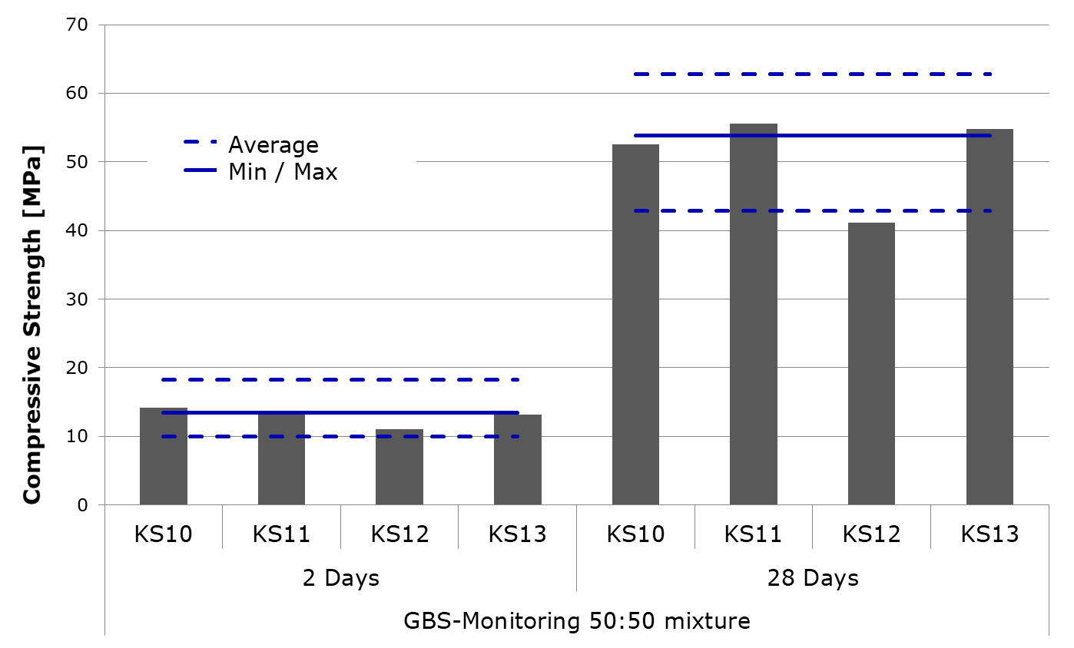
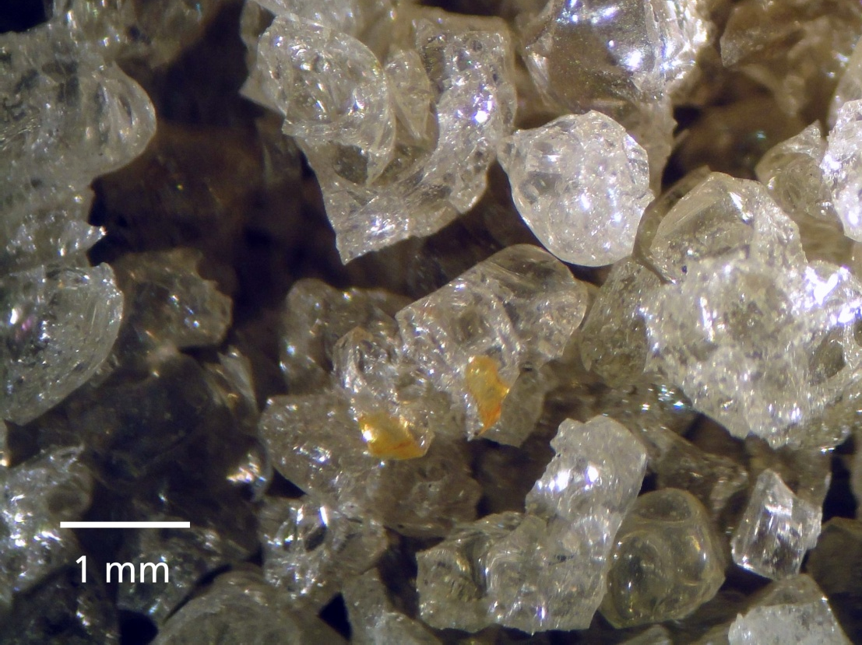
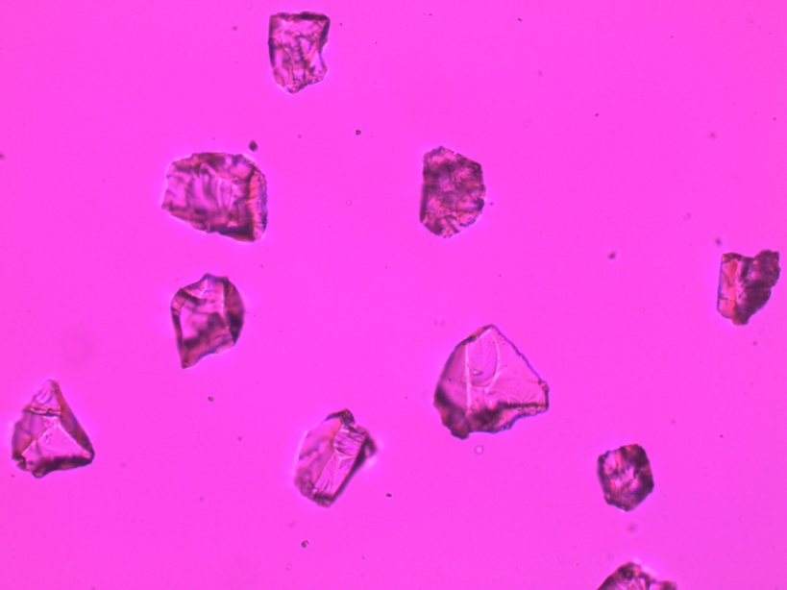
FEhS GBS monitoring
Glass content
> 99 Vol.-%

Slide 7
Composition after complete reduction
Slag | CaO | SiO₂ | MgO | Al₂O₃ | Cr₂O₃ | FeO | Fe₂O₃ | MnO | P₂O₅
 | (wt.-%)
Complete reduction | 43.7 | 22.7 | 14.0 | 12.6 | 0.19 | 0.28 | 0.18 | 4.08 | 0.11

Slide 8
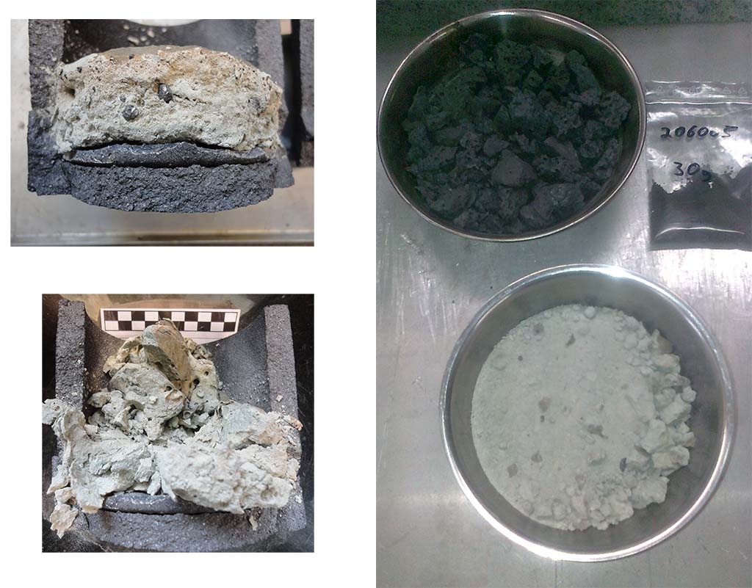
EAF slag disintegration after complete reduction

Slide 9
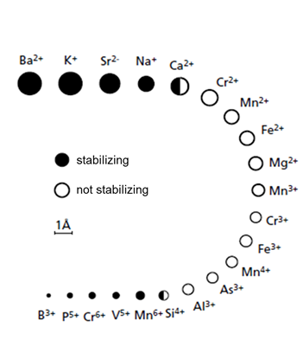
Complete Reduction – No phosphorous in slag
 | Before reduction | After reduction
Wustite FeO_{x} | X
Magnetite (Fe₃O₄) | X
Periclase (MgO) |  | X
Calcio-Olivine (β-C2S) (Ca₂SiO₄) | X
Larnite (γ-C2S) (Ca₂SiO₄) |  | X
Bredigite (Ca_{1,7}Mg_{0,3}SiO₄) | X | X
Merwinite (Ca₃MgSi₂O₈) |  | X
Gehlenite (Ca₂Al₂SiO₇) | X | X
P-content [wt.-%]
Before reduction: 0.4
After Reduction: 0.1

Slide 10
Composition after complete reduction
Slag | CaO | SiO₂ | MgO | Al₂O₃ | Cr₂O₃ | FeO | Fe₂O₃ | MnO | P₂O₅
 | (wt.-%)
Complete reduction | 43.7 | 22.7 | 14.0 | 12.6 | 0.19 | 0.28 | 0.18 | 4.08 | 0.11
Metal | C | Si | Mn | P | Cu | Sn | Cr | Mo | Ni | V
 | (wt.-%)
Complete reduction | 6.0 | 0.22 | 6.04 | 0.42 | 0.03 | 0.002 | 3.6 | 0.01 | 0.03 | 0.24

Slide 11
New idea:
Defined reduction

Slide 12
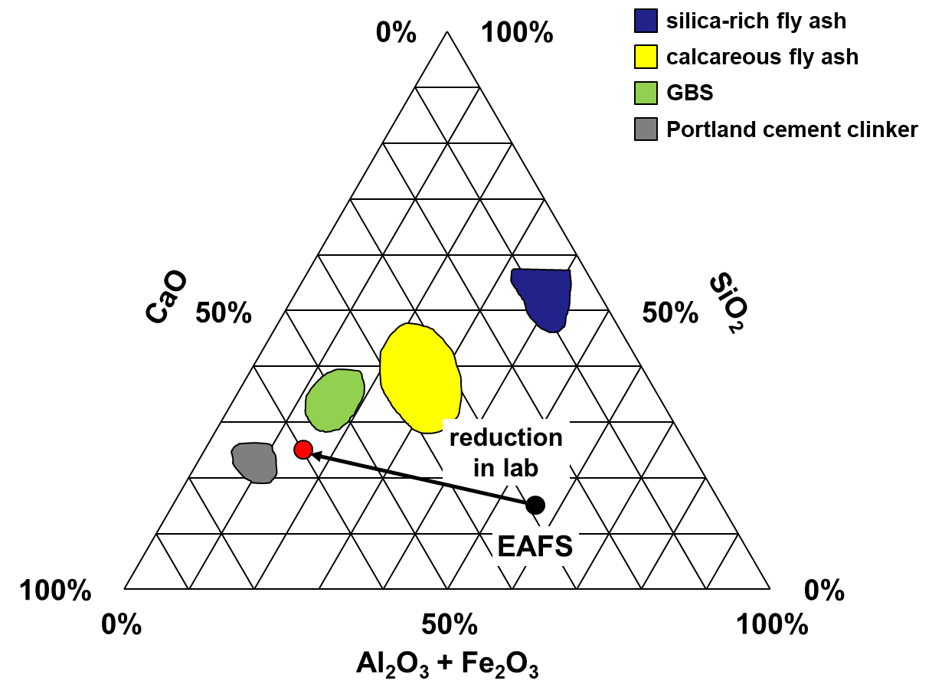
1600° C
1300° C

Slide 13
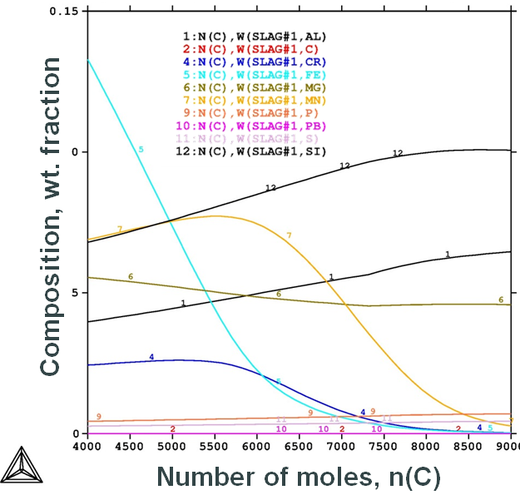
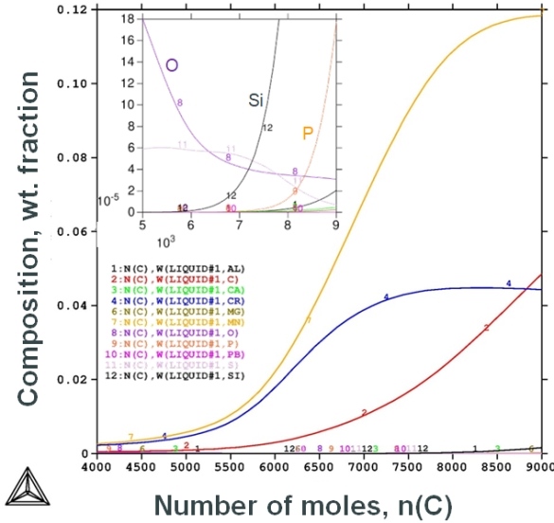
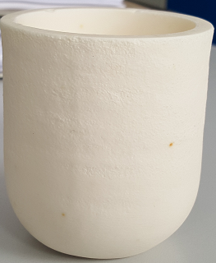
Calculations
Aim: Autarc reduction!
Reduction of EAF slag by C and Si
1) Laboratory trials in MgO-crucibles

Slide 14
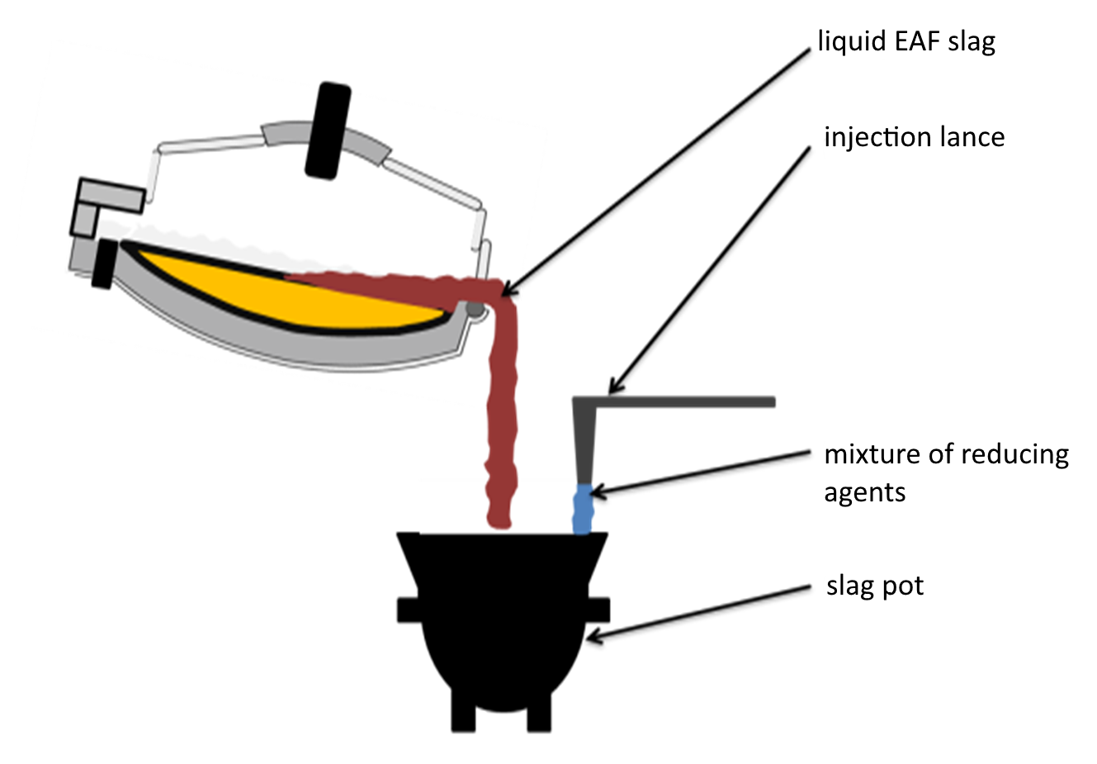
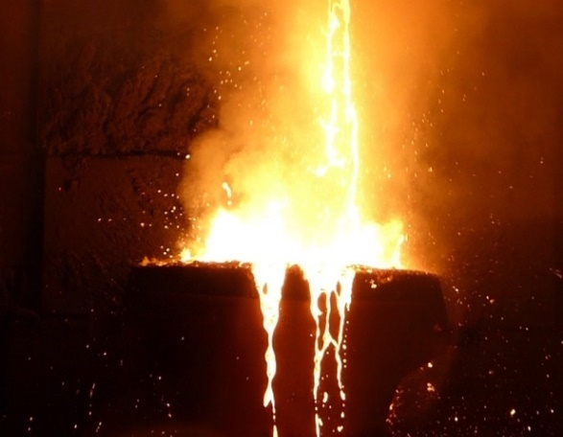
2) Pilot tests
30 tests were already performed by this procedure

Slide 15
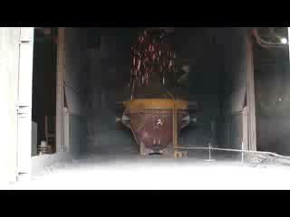
Pilot tests (not optimized)

Slide 16
Products

Slide 17
Composition of slag and metal
Slag | CaO | SiO₂ | MgO | Al₂O₃ | Cr₂O₃ | FeO | Fe₂O₃ | MnO | P₂O₅
 | (wt.-%)
Complete reduction | 43.7 | 22.7 | 14.0 | 12.6 | 0.19 | 0.28 | 0.18 | 4.08 | 0.11
Defined reduction 1 | 23.1 | 20.7 | 8.98 | 8.90 | 2.08 | 15.1 | 2.40 | 7.72 | 0.37
Defined reduction 2 | 26.8 | 24.0 | 9.10 | 8.41 | 1.49 | 10.9 | 2.96 | 8.16 | 0.39
Metal | C | Si | Mn | P | Cu | Sn | Cr | Mo | Ni | V
 | (wt.-%)
Complete reduction | 6.0 | 0.22 | 6.04 | 0.42 | 0.03 | 0.002 | 3.6 | 0.01 | 0.03 | 0.24
Defined reduction 1 | 0.4 | 5.0 | 1.2 | 0.10 | 0.14 | 0.011 | 0.85 | 0.03 | 0.09 | 0.04
Defined reduction 2 | 1.37 | 7.0 | 4.1 | 0.09 | 0.14 | 0.006 | 1.20 | 0.05 | 0.07 | 0.10
acceptable!

Slide 18
Environmental compatibility – use in road construction
Comparison reference to BTI Column test (0/32 mm, w/s ratio 2/1)
Cr | -83 % | SWS-1 | → | SWS-1
V | +300 % | SWS-1 | → | SWS-1
low reference value
F | -44 % | SWS-2 | → | SWS-1
Mo | -94 % | SWS-3 | → | SWS-1
Average of all operational trials compared to average of previous investigations
[mg/l] | Cr | Mo | V | F
SWS-1 | 0,110 | 0,055 | 0,180 | 1,1
SWS-2 | 0,190 | 0,400 | 0,450 | 4,7
SWS-3 | 0,250 | 1,000 | 1,000 | 8,5

Slide 19
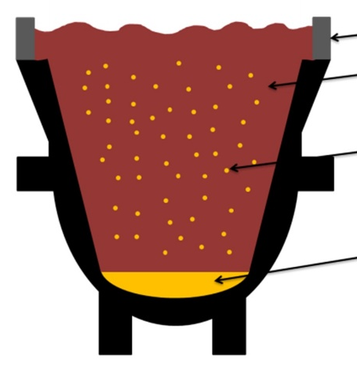
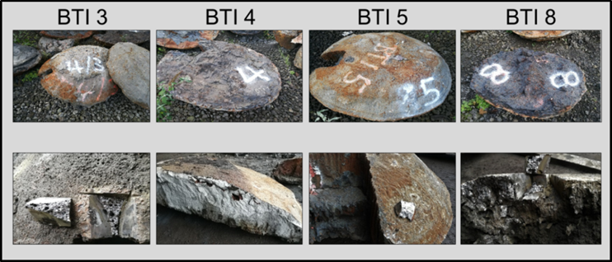
Metal recovery (defined reduction)
Recovering metal up to 20 wt.-% Metall as a „scull“
P content < 0.16 wt.-% ; ∅ 0.06 wt.-%

Slide 20
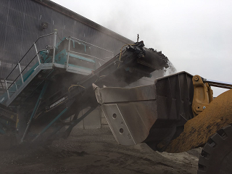
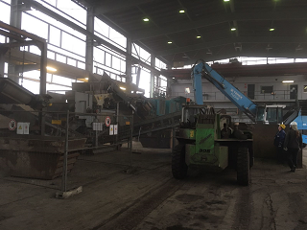
Processing of treated EAF slag

Slide 21
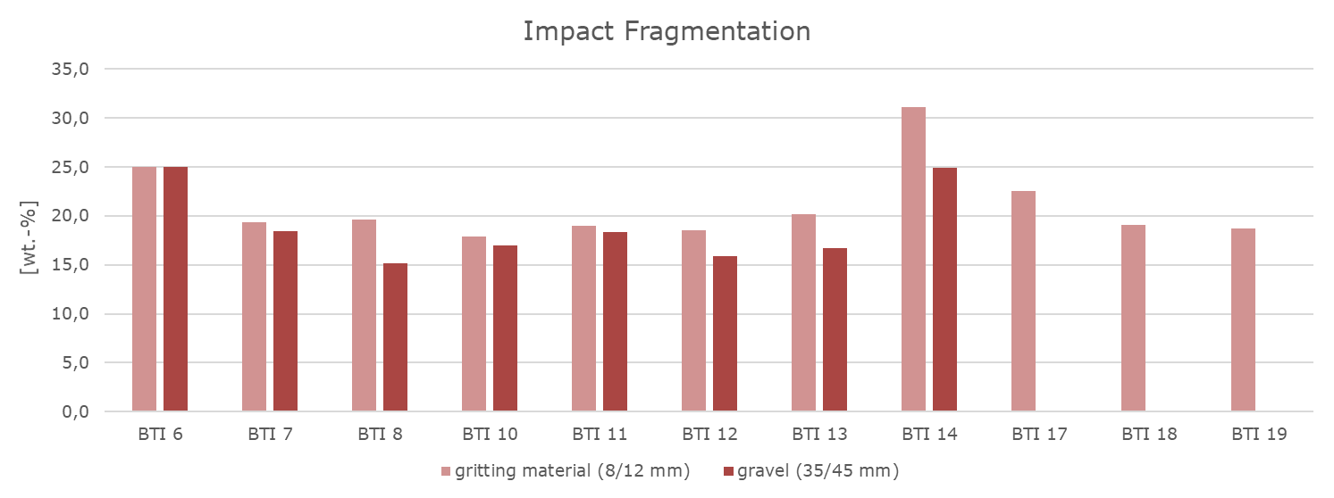
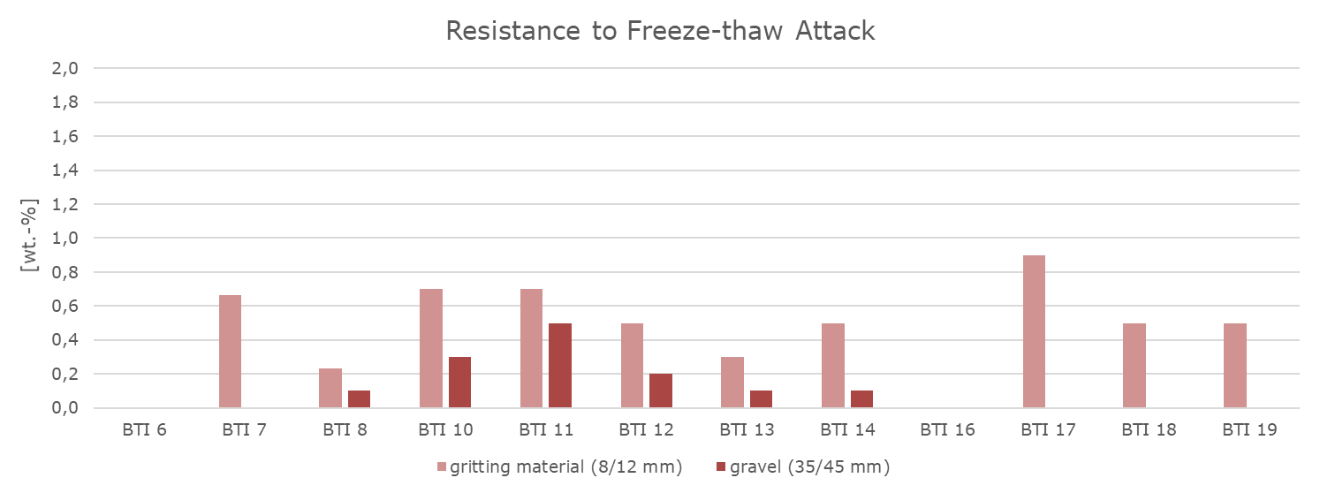
Physical properties

Slide 22
New products

Slide 23
New products
Slag | CaO | SiO₂ | MgO | Al₂O₃ | Cr₂O₃ | FeO | Fe₂O₃ | MnO | P₂O₅
 | (wt.-%)
Complete reduction | 43.7 | 22.7 | 14.0 | 12.6 | 0.19 | 0.28 | 0.18 | 4.08 | 0.11
Defined reduction 1 | 23.1 | 20.7 | 8.98 | 8.90 | 2.08 | 15.1 | 2.4 | 7.72 | 0.37
Defined reduction 2 | 26.8 | 24.0 | 9.10 | 8.41 | 1.49 | 10.9 | 2.96 | 8.16 | 0.39
Slag | CaO | SiO₂ | MgO | Al₂O₃ | Cr₂O₃ | FeO | Fe₂O₃ | MnO | P₂O₅ | C/S | C+M/ S+A
 | (wt.-%)
Complete reduction | 43.7 | 22.7 | 14.0 | 12.6 | 0.19 | 0.28 | 0.18 | 4.08 | 0.11 | 1.93 | 1.63
Defined reduction 1 | 23.1 | 20.7 | 8.98 | 8.90 | 2.08 | 15.1 | 2.4 | 7.72 | 0.37 | 1.12 | 1.08
Defined reduction 2 | 26.8 | 24.0 | 9.10 | 8.41 | 1.49 | 10.9 | 2.96 | 8.16 | 0.39 | 1.12 | 1.11
Basicity similar to blast furnace slag
⇒ GBFS possible?

Slide 24
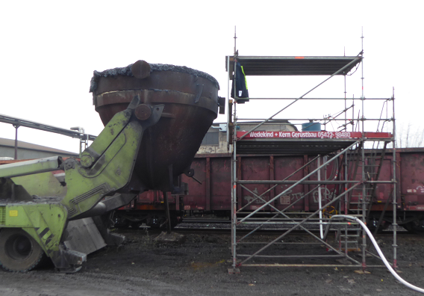
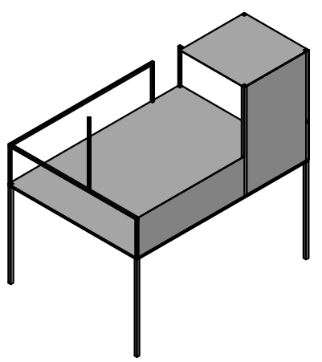
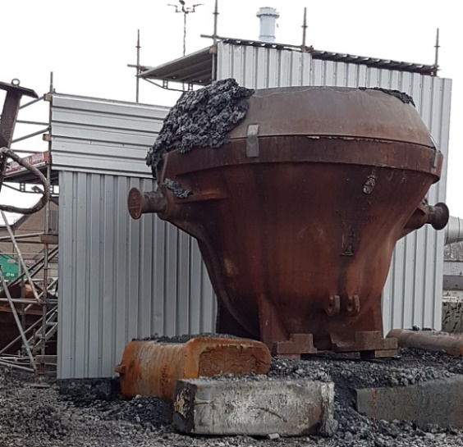
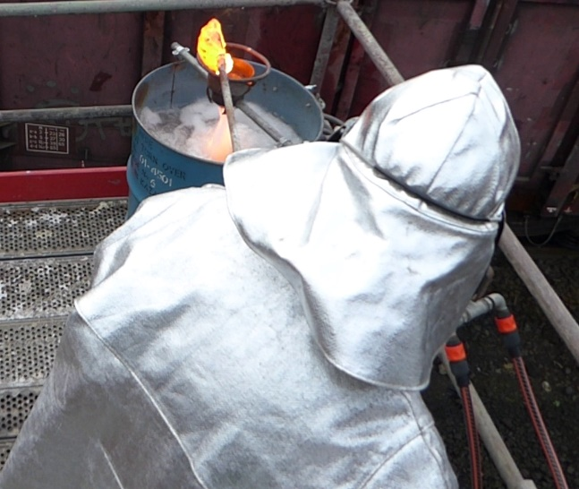
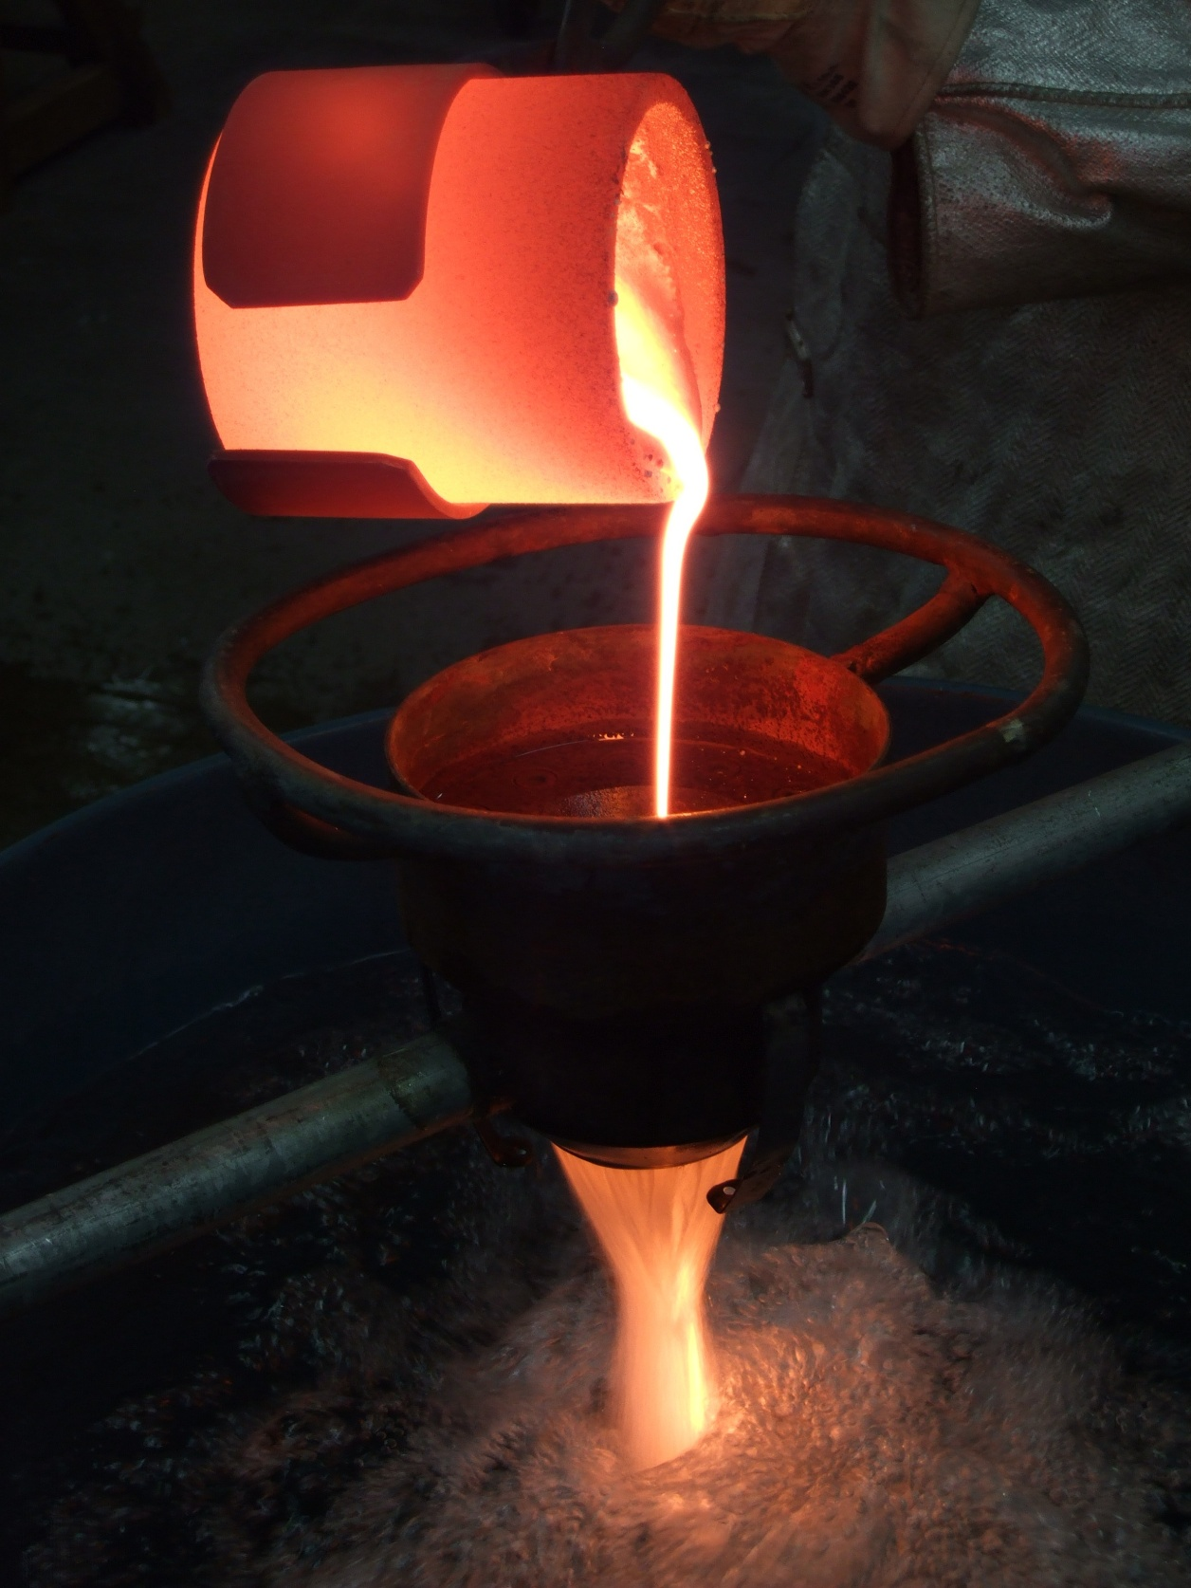
New Products? → Water granulation

Slide 25
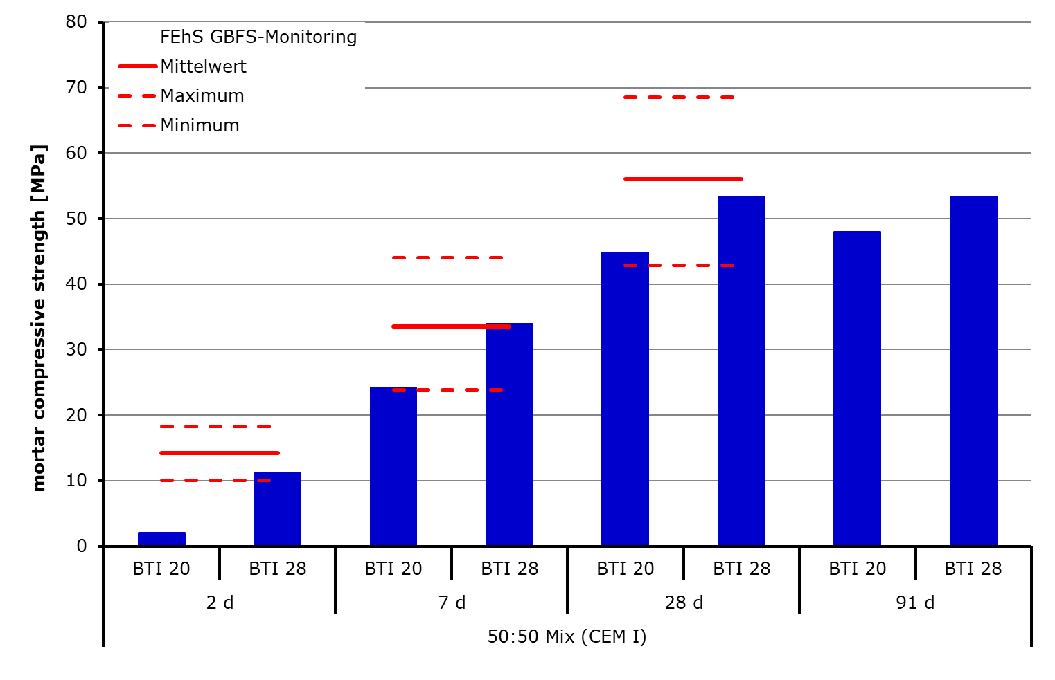
Cementitious properties
Average

Slide 26
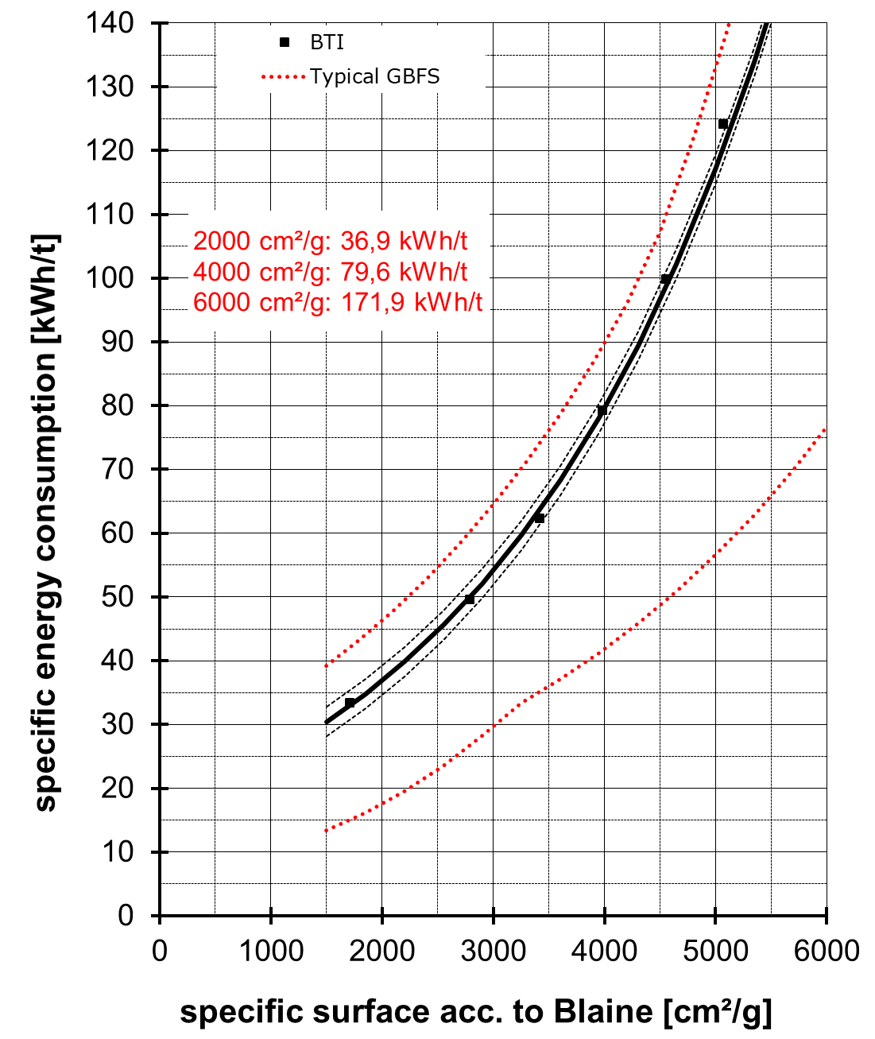
Grinding Energy

Slide 27

Conclusion
Process
Defined reduction is possible in bigger scale
Optimization is necessary to implement it to operational practice
Road construction
Environmental compatibility regarding new regulations increases
Technical properties are equal or better
Cement industry
water granulation leads to a GBFS like material
Technical properties are acceptable
⇒ Ongoing activities are focused on a robust process due to varying slag from process
We acknowledge the support of the German Environment
Foundation (DBU) for funding the presented project
(33756/01-21 „DIREKT“)

Slide 28




Contact information
David Algermissen, M.Sc.
Head of Department
Secondary Raw Materials / Slag Metallurgy
Tel.: +49 2065 9945-12
Mail: d.algermissen@fehs.de
Web: www.fehs.de

